Slide 1
Basic Elements

Slide 2
Compiling FORTRAN

Slide 3
Compiling and Linking
FORTRAN
Source
Files
FORTRAN
Object files
Files
Executable
Program
Creating a FORTRAN executable is a two step process
Compiling Source Code
Linking the Object Code to System Libraries
Compilers on LM Systems:
Intel Fortran Compiler
GNU GCC Compiler
G95 Compiler
F77 Compiler

Slide 4
LINUX

Slide 5
Compilers at LMMFC
Fortran source files are indicated by names ending in ".f", ".F", ".for", ".FOR", ".f90", ".F90", ".f95", ".F95", ".f03" and ".F03".
Fixed form source compatible with old f77 files
Files ending in ".f", ".F", ".for", and ".FOR“
Free source form
. Files ending in ".f90", ".F90", ".f95", ".F95", ".f03" and ".F03".
Files ending in uppercase letters are preprocessed with the C preprocessor by default, files ending in lowercase letters are not preprocessed.

Slide 6
Invoking the FORTRAN Compilers
The f77 compiler
Standard FORTRAN 77 compile
Invoking the f77 compiler:
f77 –o program source1.f source2.f source3.f
The G95 compiler
FORTRAN 95 with 2003 extension
http://www.g95.org/downloads.shtml
Invoking the G95 compiler:
g95 –o executable source1.f95 source2.F90 source3.f
The Intel Fortran Compiler
FORTRAN 95 with 2003 extension
http://www.intel.com/software/products/compilers/docs/flin/main_for/index.htm
Invoking the Intel compiler:
ifort ––o executable source1.f95 source2.f90 source3.F90

Slide 7
WINDOWS

Slide 8
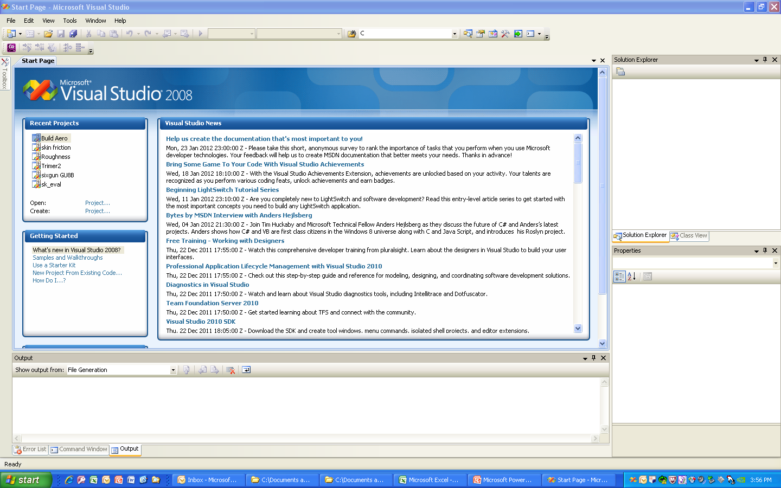
MICROSOFT VISUAL STUDIO

Slide 9
The FORTRAN Language

Slide 10
The FORTRAN Character Set
FORTRAN 95 consists of 85 symbols
FORTRAN 2003 consists of 96 symbols
Note: FORTRAN is not case sensitive

Slide 11
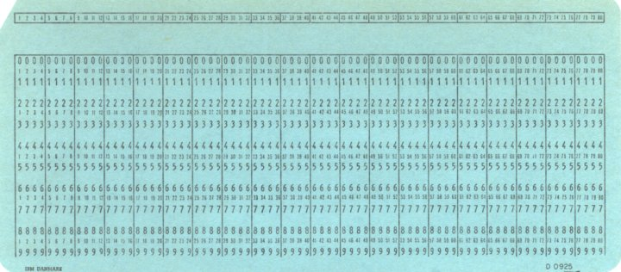
FORTRAN 77 Statement
Col. 7 - Start of FORTRAN Statement
Col. 6 – Reserved for Continuation Statement
Col. 1 – Used for Comment Statement
Col. 72 - End of FORTRAN Statement

Slide 12
FORTRAN95/03 Statements
Two Statement types
Executable Statements
Describes actions taken by the program when executed
Non-executable Statements
Provides information necessary for proper operation of the program
Each line may be up to 132 characters long.
Statements may be continued on the next line by ending the current line (and optionally starting the next line) with “&”.
FORTRAN 95 statement can be continued up to 40 lines ( FORTRAN 2003 Statement – 256 lines).

Slide 13
Statement Labels
A statement label can be any number between 1 and 99999.
It is the name of the statement.
It must be unique within the program.
Statement labels are rare in modern FORTRAN codes

Slide 14
Comments
Any characters following an exclamation point (!) are comments.
Comments may appear on the same line as an executable statement
All text from the ! to the end of the line are ignored by the compiler
Older FORTRAN code uses a “C” or “ * ” in column 1 to designate a comment statement.
Comments help us document the proper operation of the code.

Slide 15
Program Structure
FORTRAN programs are divided into three sections:
The declaration section
Consists of non-executable statements at the beginning of the code
Used to define:
The name of the program
The number and type of variables
The execution section
Consists of one or more statements describing the actions to be performed by the program
The termination section
Consists of a statement or statements stopping the execution of the program
Tells the compiler that the program is complete

Slide 16
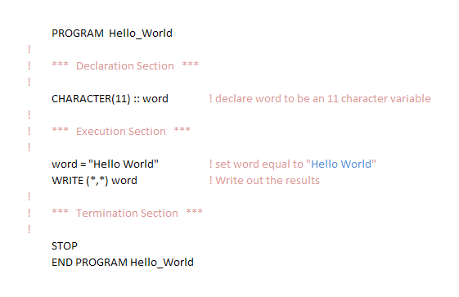
Simple Program

Slide 17
Constants and Variables
A FORTRAN constant is a data object defined before program execution
A FORTRAN variable is a data object that can change during execution
FORTRAN 77 variable names limited to 6 characters
FORTRAN 90/95 variable names can be up to 31 characters long
FORTRAN 2003 variable names can be up to 63 characters long
Data types of FORTRAN constants and variables:
5 Intrinsic data types:
INTEGER, REAL, COMPLEX, LOGICAL, CHARACTER
Derived data type

Slide 18
Default and Explicit Variable Types
Default typing -
Any variable beginning with I, J, K, L, M, or N is an INTEGER variable.
Any variable starting with another letter is a REAL variable.
Explicit typing –
These variables are declared at the beginning of the program
CHARACTER and other intrinsic type variables must be Explicitly declared.

Slide 19
Type Declaration Statements
FORMAT:
INTEGER :: var1 [, var2, var3, …]
REAL :: var1 [, var2, var3, …]
CHARACTER (Len = <Len>) :: var1 [, var2, var3, …]
EXAMPLES:
INTEGER :: day, month, year
REAL :: second
CHARACTER (Len = 10) :: first, last
CHARACTER :: initial
CHARACTER (15) :: id
Type declaration statements
Placed just after the PROGRAM statement
Placed before first execution statement

Slide 20
Named Constants
FORMAT:
Type, PARAMETER :: name = value [, name2 = value2, name3 = value3, …]
EXAMPLE:
REAL, PARAMETER :: pi = 3.141593
Named constants are defined using the PARAMETER attribute of a type declaration statement
If the constant is of type CHARACTER, then the length of the constant does not need to be specified since the constant is defined in the same statement.

Slide 21
Assignments & Calculations
Calculations are specified with an assignment statement :
The equal sign is the assignment operator
In FORTRAN the “ = “ means: Store the value of expression into location variable-name.
Standard arithmetic operators:
+ Addition, - Subtraction, * Multiplication, / Division, ** Exponentiation
The following rules apply:
No two operators may occur side by side
Implied multiplication is illegal
Parentheses may be used to group terms whenever desired.
Variable-name = expression

Slide 22
FORTRAN Arithmetic
Integer Arithmetic
Always produce an integer result
The computer automatically truncates the fractional part of the result
Real Arithmetic
Arithmetic between real constants and variables
Always produce a real result
Numbers are stored with limited precision so quantities that are theoretically equal may not be equal when evaluated.
Mixed-Mode Arithmetic
An operation between an integer and a real number is called a mixed-mode operation.
An expression containing one or more mixed-mode operations is called a mixed-mode expression.
In mix-mode operations, FORTRAN converts the integer into a real number then performs the operation to obtain a REAL result.
The automatic conversion does not occur until a real number and an integer both appear in the same operation.
Automatic type conversion also occurs when the variable to which the expression is assigned is of a different type than the result of the expression.

Slide 23
Hierarchy of Operations
The contents of all parentheses are evaluated first, starting from the innermost pair and working out.
All exponentials are evaluated, working from right to left.
All multiplications and divisions are evaluated, working left to right.
All additions and subtractions are evaluated, working left to right.

Slide 24
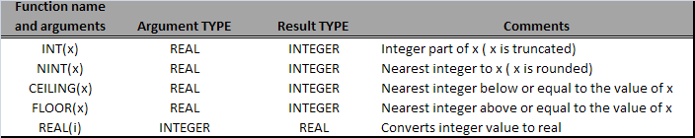
TYPE Conversion Functions
FORTRAN 95/2003 includes five type conversion functions
REAL, INT, NINT, CEILING, and FLOOR.
These functions allow explicit control of the conversion between integer and real values.

Slide 25
Intrinsic Functions
Many of the most common functions are built directly into the FORTRAN language.
A FORTRAN function takes one or more input values, and calculates a single output.
Input values are know as arguments
Output of a function is a single number, logical value, or character string which can be used together with other functions, constants, and variables in FORTRAN expressions.
Functions may be used in expressions anywhere that a constant or variable may be used.
Functions may never appear on the left side of the assignment operator since they are not memory locations and nothing can be stored in them.

Slide 26
List-Directed Input
The TYPE of the variables in the variable list determine the required format of the input data.
Values to be read must match the variables in the input list both in order and TYPE.
Each read statement begins reading from a new line of input data.
input-list
List of variables into which the values being read are placed.
Multiple variables are separated by a comma
READ (*,*)
The first field specifies the input/output unit from which the data is being read. The asterisk indicates the data is to be read from standard input.
The second field in the parentheses specifies the format in which the data is to be read. The asterisk in this field means that list-directed input is to be used.
READ (*,*) input-list

Slide 27
List-Directed Output
WRITE (*,*) output-list
The TYPE of the values in the output list of the write statement determine the format of the output data.
The output list may contain constants, variables, functions, and expressions. In each case the value is output to the standard output device
The two asterisks has the same meaning as for a list-directed read statement
The output list is a list of data items that are to be written out.

Slide 28
Variable Initialization
There are three methods for initializing variables in a FORTRAN program
Assignment Statements
READ Statements
Initialization in the TYPE declaration statement
Uninitialized variables can present a serious problem since they are handled differently by different compilers and computers.
X = 5.0
READ (*,*) i, X, Y, Z
type :: var1 = value, [var2 = value, … ]

Slide 29
IMPLICIT NONE
This statement disables the default typing provisions of FORTRAN.
Any variable that does not appear in an explicit type declaration statement is considered an error
The programmer must explicitly declare the type of every variable in the program.
Advantages of using this statement:
A majority of errors are simple typographical errors. The IMPLICIT NONE statement catches these errors at compile time.
It helps make the code more maintainable by requiring that all the variables used in the code be declared at the beginning of the code.
Use of this statement becomes more and more important as the size of the programming project increases.

Slide 30
Good Programming Practices
Use meaningful variable names whenever possible.
Always use the IMPLICIT NONE statement to catch typographical errors at compilation time
Create a data directory in each program you write.
Explicitly declare and define each variable in the program.
Should include the physical units associated with each variable.
Use a consistent number of significant digits in constants.
Be sure to specify all constants with as much precision as your computer will support.
Use integer arithmetic only for things intrinsically integer such as counters.
Avoid mixed-mode arithmetic except for exponentiation.
Use parentheses whenever necessary to improve the readability of your expressions.
Initialize all variables before using them.
Echo input data to make sure you are reading what you expected.
Always print the physical units associated with any value being written out.

